Slide 1
A practical SDMX /VTL implementation using Trevas and FMR
Nicolas Laval, Making Sense Glenn Tice, BIS Monetary and Economics IT
2024 SDMX Experts Workshop

Slide 2
VTL integration with SDMX
VTL has its own information model based on GSIM, but is designed to be compatible with SDMX and other standards like DDI
The SDMX Section 6 Technical Notes explains how VTL and SDMX work together
Two important elements for a practical implementation are:
How VTL programs can be stored and exchanged together with the SDMX structures of the datasets involved
How SDMX artefacts can be referenced in VTL code as inputs and / or outputs of Transformations and for validation Rules

Slide 3
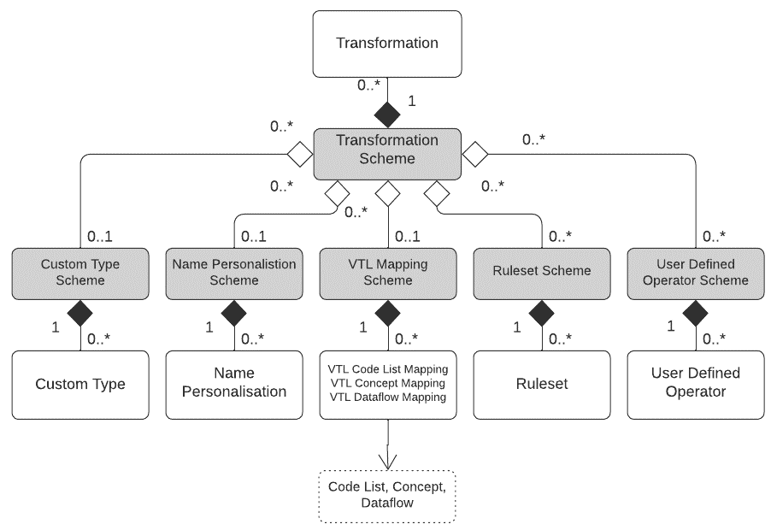

Storage and exchange of VTL
In the SDMX context, VTL code is managed as structural metadata
The SDMX information model provides several artefacts for this purpose
Centres on the Transformation Scheme artefact which encapsulates a VTL program
Allows VTL to be stored and exchanged in the same way as other SDMX structures

Slide 4
Referencing SDMX artefacts in VTL Statements and Rules
SDMX artefacts can be referenced in VTL code using full or partial URNs
DS_r := ‘urn:sdmx:org.sdmx.infomodel.datastructure.Dataflow=ECB:EXR(1.0)’ / 10
define datapoint ruleset DPR_1 (valuedomain ‘SDMX:CL_AREA(2.0)’ as A, ‘IMF:CL_CURRENCY(1.6)’ as B)
…
end datapoint ruleset
Or, by user defined aliases defined using VTL Mapping Schemes which allow SDMX artefacts to be given symbolic names
DS_r := EXCHANGE_RATES / 10

Slide 5
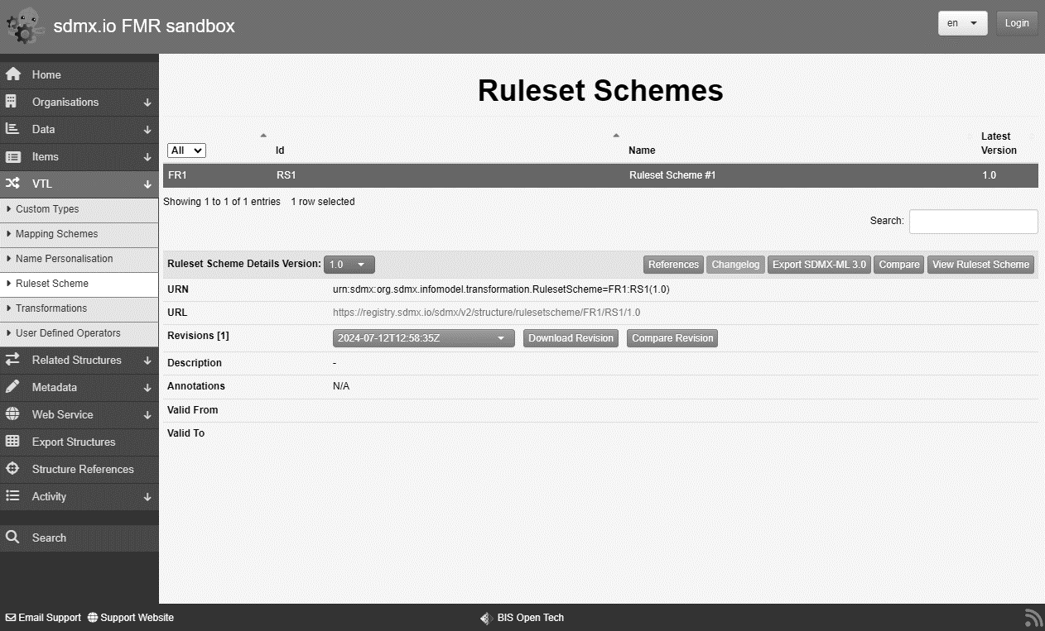
FMR support for storage and exchange of VTL
All VTL structures supported in FMR 11
VTL syntax checking on structure submission
Basic authoring and maintenance using the FMR web user interface
Better VTL code development environments can interface to the FMR repo by the REST API

Slide 6
FMR support for referencing SDMX artefacts in VTL code
Deep structure cross referencing
FMR identifies SDMX artefacts referenced by full or partial URN in the VTL code
Manages them as structural metadata cross references
Why?
Execution engines can efficiently retrieve both the VTL program and structural metadata for input datasets and validation rules in a single REST web service call for the Transformation Scheme with references=descendants
Enforces metadata referential integrity

Slide 7
FMR support for referencing SDMX artefacts in VTL code
Example
A Transformation Scheme is constructed with a single Transformation
DS_r <- ‘ECB:EXR(1.0)’ / 10
On submission of the Transformation Scheme to the metadata registry, FMR will:
Syntactically analyse the VTL code
Identify ECB:EXR(1.0) as an SDMX partial URN
Infer that it is a Dataflow from the code context
Verify that the Dataflow exists in the registry
Create a cross reference to the Dataflow from the Transformation Scheme
Store the Transformation Scheme

Slide 8
Executing a VTL program using Trevas and FMR
FMR
SDMX REST API
SDMX structure query
Transformation Scheme by ID
references = descendants
Response
SDMX structure message
Transformation Scheme – the VTL program
Just the necessary structural metadata
Trevas
VTL execution
Input dataset(s)
Output dataset(s)
https://registry.my.org/sdmx/v2/structure/transformationscheme/all/MY_VTL_TRANS/+/?references=descendants

